Slide 1

CS-M151B
Computer Systems Architecture
Blaise Tine
UCLA Computer Science

Slide 2

Attendance

Slide 3
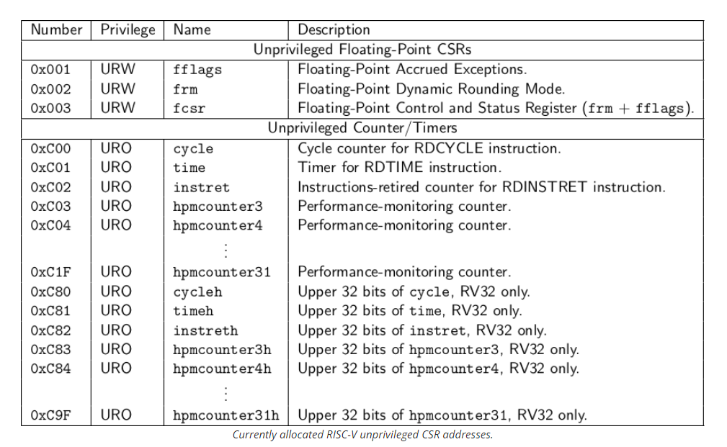
RISC-V Control and Status Instructions
User-level CSR Table
Standard mapping
FPU flags
Cycle
Time
Instret
HPM Counters
Notes:
HPM: hardware performance monitoring counter

Slide 4
RISC-V Control and Status Instructions
Privilege Levels: defines the level of access that software has to the processor and system resources. They enable:
Access control: control what an application can do
Security: run an application in isolation from others

Slide 5
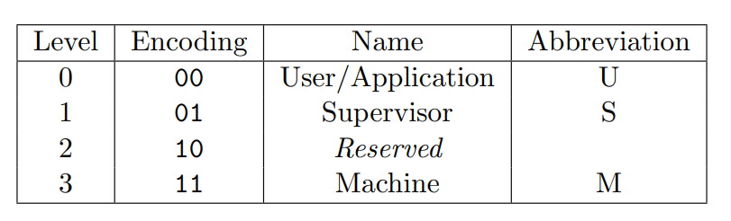
RISC-V Control and Status Instructions
RIS-V Privilege Levels
User-level (U)
Hypervisor (H)
Supervisor (S)
Machine-level (M)
Hypervisor
H

Slide 6
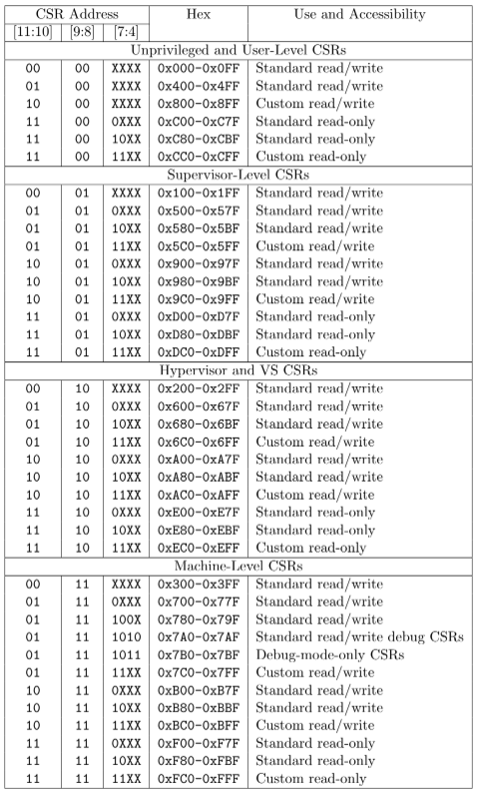
RISC-V Control and Status Instructions
CSRs Privilege Mapping
Why reserving dedicated bits for level?
Notes:
Reserving the bit simplifies the hardware decoding of the CSR address and enables the hardware to perform privileged detection in parallel.

Slide 7
RISC-V Control and Status Instructions
User-level (U): User-level CSRs are accessible from the user mode, which is the least-privileged mode of operation. These registers typically contain information or controls that are safe to expose to user applications, such as performance counters that can be read without compromising system integrity.

Slide 8
RISC-V Control and Status Instructions
Supervisor-level (S): Supervisor mode is used by operating systems to control system resources and manage user applications. It has a lower privilege than M-mode but can still perform system-level tasks.

Slide 9
RISC-V Control and Status Instructions
Hypervisor-level (H): Hypervisor mode is an optional privilege level introduced in newer versions of the RISC-V specification, designed for virtualization. It sits between M-mode and S-mode and is used to run and manage virtual machines.

Slide 10
RISC-V Control and Status Instructions
Machine-level: Machine-level CSRs are accessible from machine mode, which is the most privileged mode of operation. These registers are used for controlling low-level, sensitive aspects of the hardware, such as interrupt handling, exception handling, and access to physical memory.
Note: default level for low-level embedded CPUs

Slide 11
RISC-V Control and Status Instructions
How is the privilege level set/modified?
CPU starts at machine level (M)
S/W can use CSR mstatus to lower the privilege level
CPU can use exception handling to increase the privilege level
RISC-V mret, sret, uret are system return instructions for switching back to previous privilege level after exception handling.

Slide 12
RISC-V Control and Status Instructions
How is the privilege level enforced?
If software running at a lower privilege level attempts to execute a privileged instruction, or a protected address space, or privileged interrupt, the processor will raise an exception

Slide 13
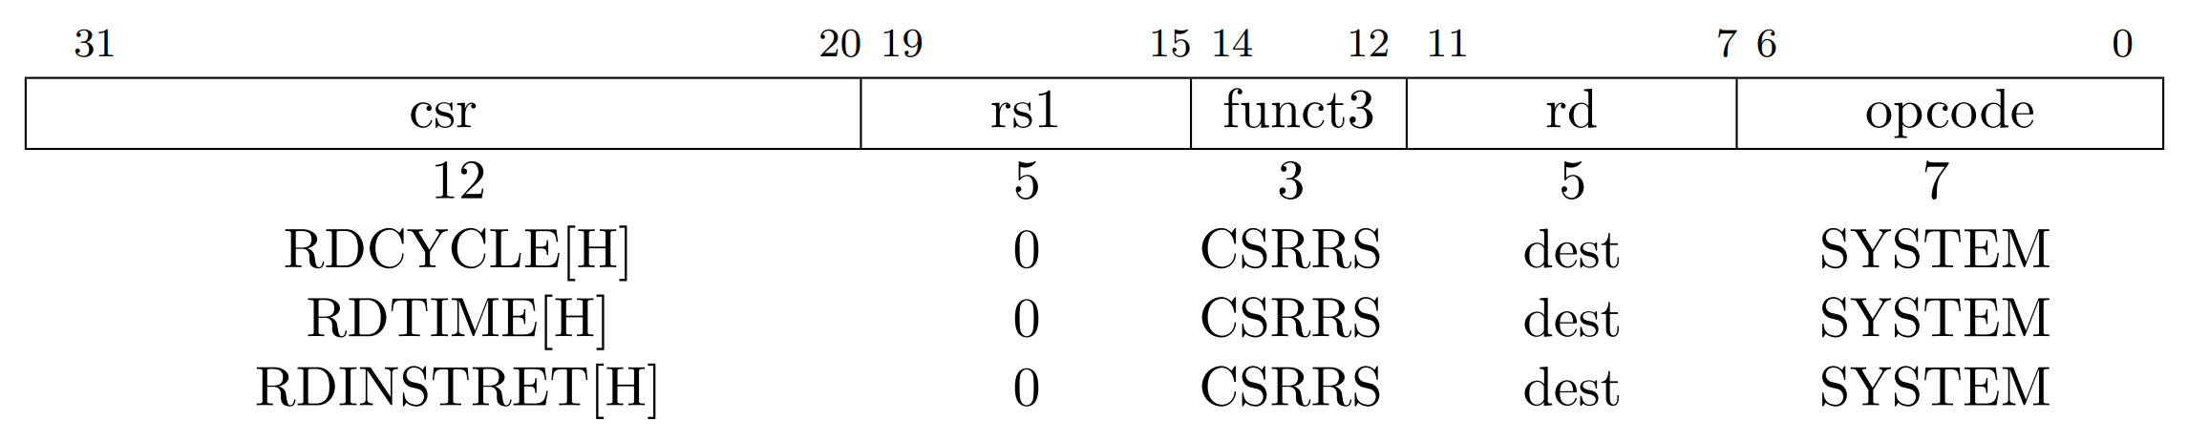
RISC-V Control and Status Instructions
Timers and counters
64-bit registers
RD_CYCLE: total cycle time
RD_TIME: wall-clock time
RD_INSTRET: total instructions
Notes:
walltime is the actual time taken from the start of a computer program to the end

Slide 14
RISC-V Control and Status Instructions
Timers and counters
How to read RD_CYCLE on 32-bit machine?
Why could this be challenging?
Counter 32-bit overflow
Solution
Read Low 32-bit
Read high 32-bit

Slide 15
RISC-V Control and Status Instructions
Assembly code
csrrs x2, cycle, x0
csrrs x3, cycleh, x0
What timing issue may emerge from the above code?
x2 and x3 may not match
Hundreds of CPU cycles can happen between the two calls
Reading cycleh could happen after cycle 32-bit overflow

Slide 16
RISC-V Control and Status Instructions
Solution
loop: csrrs x3, cycleh, x0
csrrs x2, cycle, x0
csrrs x4, cycleh, x0
bne x3, x4, loop
How does this work?
It takes a while for cycleh change
The loop handle the overflow cases

Slide 17
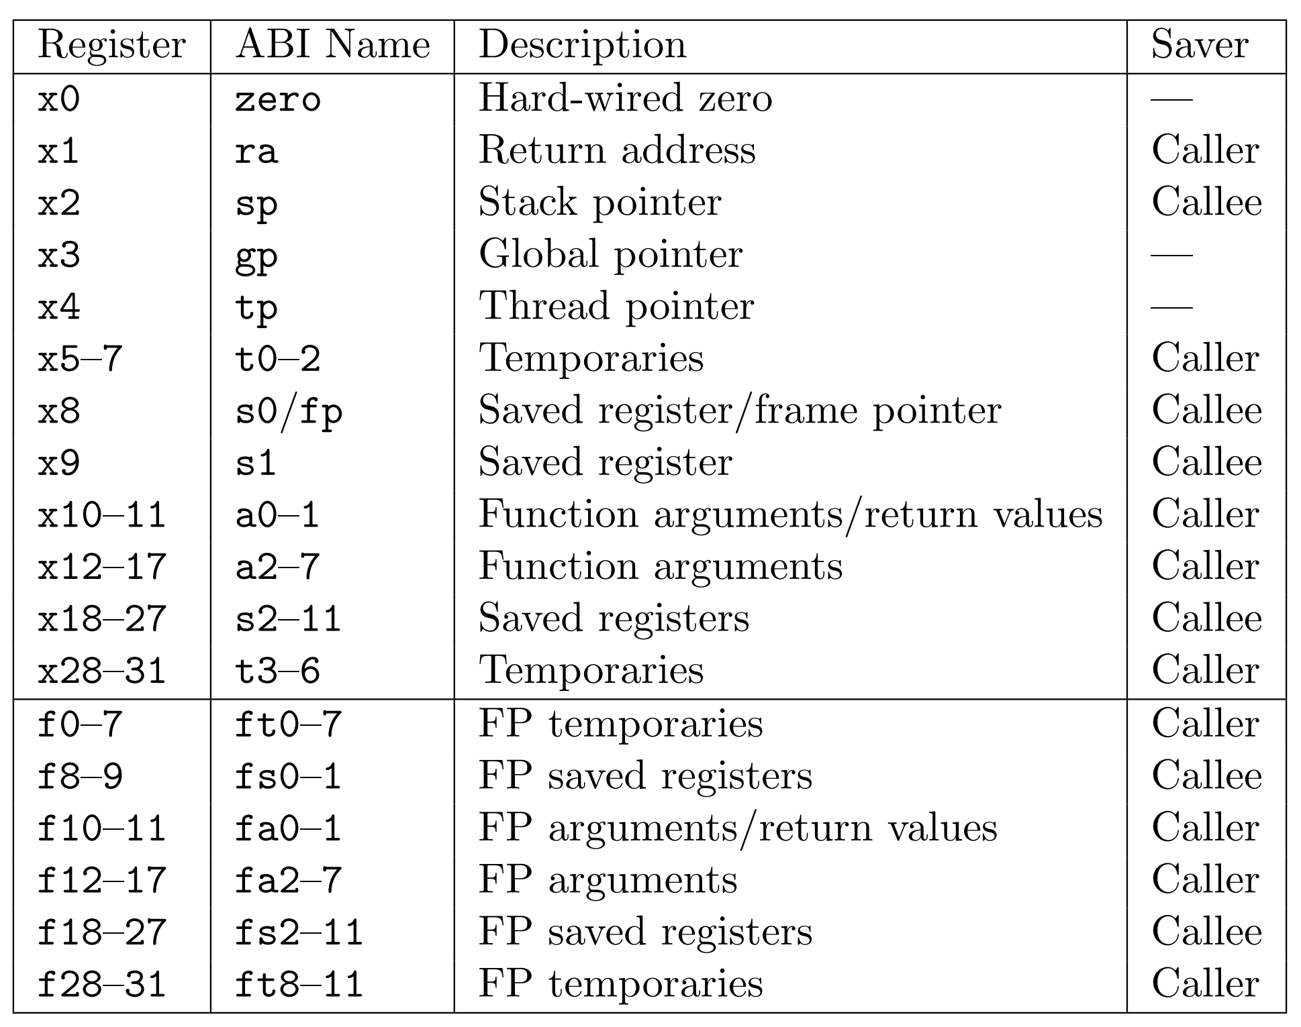
RISC-V Registers
32 general-purpose registers
Separate floating-point registers
Register r0=0x0 - why?
Hidden PC register
accessible via CSRs only
Notes:
Why Zero?
- predominant value for comparisons and arithmetic operations
- simple instruction decoding when no registers is needed
- simple register file access logic when no register is needed

Slide 18
RISC-V Registers
ABI Calling convention:
Arguments: a0-7
Return: r0
Temporaries: t0-6
Saved registers: s0-11
Who back up registers during calls?
Caller/parent
or Callee/child
Notes:
Why Zero?
- predominant value for comparisons and arithmetic operations
- simple instruction decoding when no registers is needed
- simple register file access logic when no register is needed

Slide 19
RISC-V Registers
Return address (ra)
Store the return address during function calls
Hold the next PC of the caller
Example: what is the value of ra when bar() is executing?
void bar() {
<print(“hello”);>
}
void foo() {
bar(); // call bar()
<print(“world\n”);>
}
# foo
0F00: ???
0F04: ???
0F08: jal ra, 0xF80
0F0C: ???
…
# bar
0F80: ???
0F84: ???
0F88: ???
0F8C: jalr x0, 0(ra)
Notes:
ra will hold the next instruction address when calling jal.

Slide 20
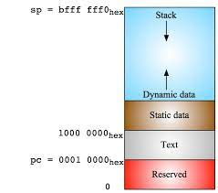
RISC-V Registers
Stack pointer (sp)
Used for managing function call stack.
The stack holds function’s temp variables that could not fit into registers.
Initialized to a starting location at boot time.
Stack base address decided by startup code.
la is a “load address” pseudo instruction
resolve to one or multiple RISC-V native instructions
depending on address value
# stack initialization
la gp, STACK_BASE_ADDR

Slide 21
RISC-V Registers
Stack pointer (sp)
Example: A program uses 16 bytes of stack storage.
# Assume that x5 and x6 contain values that we want to preserve
# First, we'll adjust the stack pointer to allocate 8 bytes of space
addi sp, sp, -8 # Decrement the stack pointer by 8 bytes
# Now we'll store x5 and x6 onto the stack at the allocated space
sw x5, 0(sp) # Store x5 at the beginning of the allocated space
sw x6, 4(sp) # Store x6 right after x5
# ... the code can now use x5 and x6 for other operations…
add x5, x0, x1
add x6, x0, x1
# To restore the values of x5 and x6, we'll load them back from the stack
lw x5, 0(sp) # Load x5 from the stack
lw x6, 4(sp) # Load x6 from the stack
# Finally, we'll adjust the stack pointer back to free the 8 bytes
addi sp, sp, 8 # Increment the stack pointer by 8 bytes to restore its original value

Slide 22
RISC-V Registers
Global pointer (gp)
Points to the middle of a global data segment
Why the middle?
Reduces instruction’s immediate value when accessing global variables
Recall LD/ST instruction use signed immediate offsets
Example C code:
int counter = 10;
void increment_counter() {
counter++;
}
int main() {
increment_counter();
return 0;
}

Slide 23
RISC-V Registers
Global pointer (gp)
Initialized to a starting location at boot time.
Linker computes and exports __global_pointer macro to startup code
la is a “load address” pseudo instruction
resolve to one or multiple RISC-V native instructions
depending on address value
# stack initialization
la gp, __global_pointer

Slide 24
RISC-V Registers
Global pointer (gp)
Assembly program
increment_ counter :
lw t1, 0(gp) # Load current value of counter
addi t1, t1, 1 # Increment the value
sw t1, 0(t0) # Store the incremented value back to counter
ret
main:
call increment_ counter
li a0, 0 # Set return value of main to 0
ret

Slide 25
RISC-V Registers
Thread pointer (tp)
used to efficiently access thread-local storage (TLS)
TLS holds data unique to each thread in a multi-threading environment
Example:
#include <iostream>
#include <thread>
#include <vector>
thread_local int tl_counter = 0;
void incrementCounter() {
tl_counter++; }
int main() {
std::vector<std::thread> threads;
for(int i = 0; i < 5; ++i) {
threads.push_back(std::thread(incrementCounter));
} for(auto& t : threads) t.join(); return 0;
}

Slide 26
RISC-V Registers
Thread pointer (tp)
Initialized to a starting location at boot time.
Linker computes and exports __tcb_aligned_size macro to startup code.
csrr t0, VX_CSR_MHARTID
sll t1, t0, STACK_LOG2_SIZE #
sub sp, sp, t1
# set thread pointer register
# ensure cache line alignment
la t1, __tcb_aligned_size # allocated TLS size
mul t0, t0, t1
la tp, _end + 63
add tp, tp, t0
and tp, tp, -64
ret

Slide 27
RISC-V Registers
Thread pointer (tp)
Assembly code for incrementCounter()
# Pseudocode for RISC-V assembly to increment a TLS variable
# Assume that the offset of tl_counter within the TLS is known and is 'offset'
incrementCounter:
# Load the address of tl_counter from the thread's TLS using the 'tp' register
addi t0, tp, offset # t0 = address of tl_counter
# Load the current value of tl_counter
lw t1, 0(t0) # t1 = *t0 (the value of tl_counter)
# Increment the value
addi t1, t1, 1 # t1 = t1 + 1
# Store the incremented value back into tl_counter
sw t1, 0(t0) # *t0 = t1
# Return from the function
ret
Notes:
.

Slide 28
Review: Digital Circuits

Slide 29
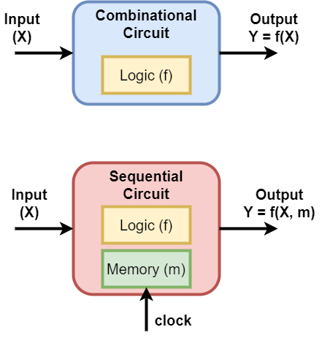
Combinational Circuits
Combinational circuits
Output depends on current inputs only
Consist of a connection of multiple logic gates
And/Or/Not

Slide 30
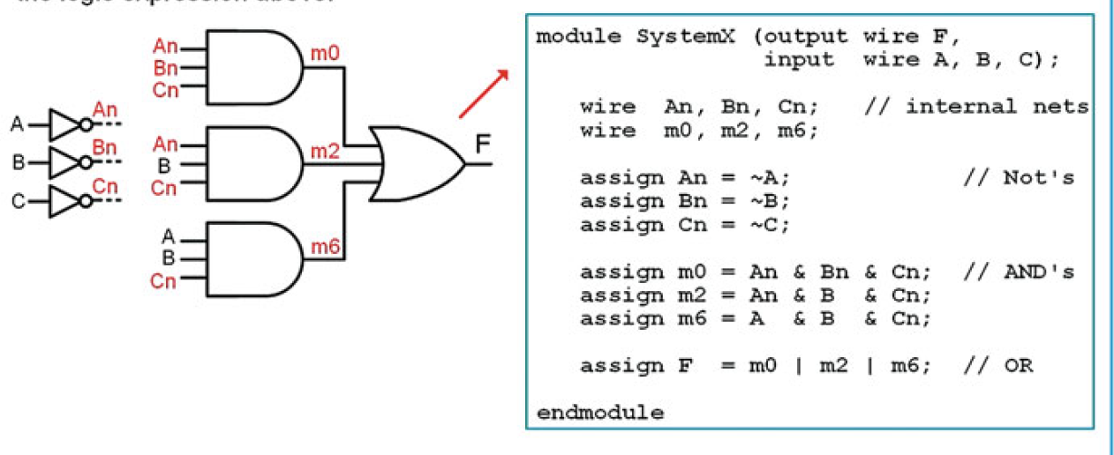
Combinational Circuits
Combinational circuits
Example1
From: Quick start Guide to Verilog (© springer Nature Switzerland)

Slide 31
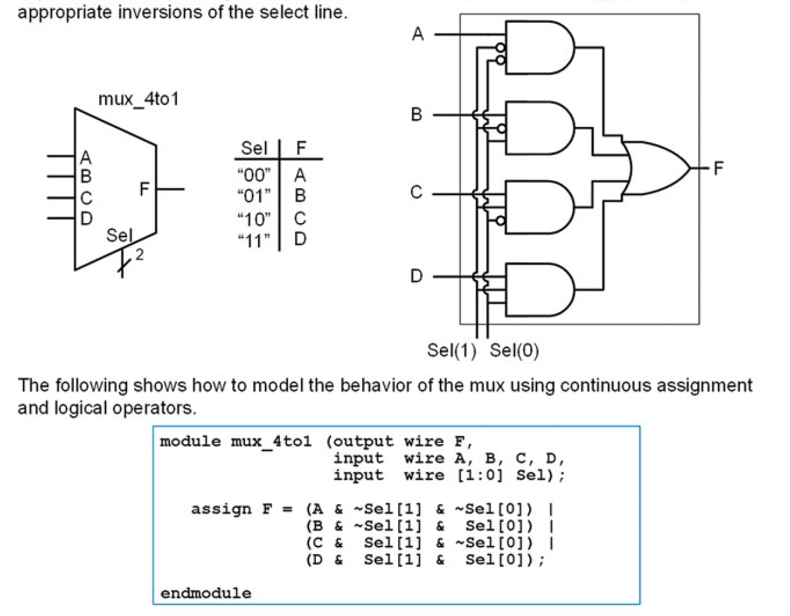
Combinational Circuits
Combinational circuits
Example2: multiplexer
From: Quick start Guide to Verilog (© springer Nature Switzerland)

Slide 32
Sequential Circuits
Sequential circuits
Output depends on current inputs and prior state
Need a storage/memory to hold prior state
e.g. storage element
D-flip-flops
RAMs
Notes:
RAM: random addressable memory

Slide 33
Sequential Circuits
D-Flip-flop:
Digital storage element
Input is propagated to output at the rising edge of the clock
Registers are implemented using D-Flip-flops
From: Quick start Guide to Verilog (© springer Nature Switzerland)

Slide 34
Applications of D-Flip-Flop
D-Flip-flop are use for:
Data storage
Data synchronization
Finite state machines
Pipelining
Timing resolution
Reduce combinational propagation delays
Improve clock speed
Combinational Logic
Register
clock
Notes:
Signal is stronger at the output of D-flip-flop

Slide 35
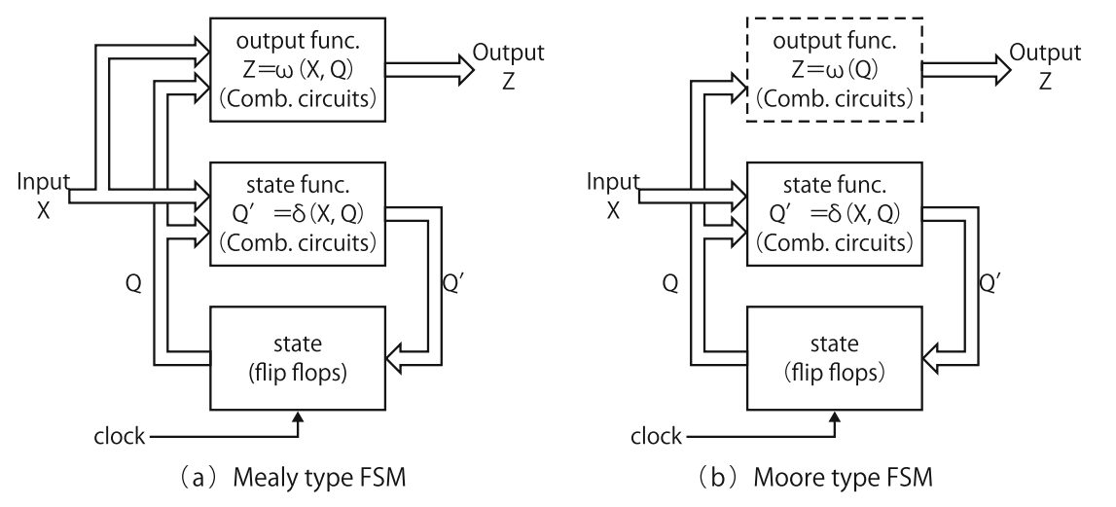
Finite State Machines
Definition: State-driven model of computation to design sequential circuits.
Mealy type FSM
(state, input) → output
Pros: Smaller number of states
Due to partial inputs handling
Cons: Input critical path
Why?

Slide 36
Finite State Machines
Moore type FSM
(state) → output
Pros: High-speed
Why?
Cons: Large number of states
due to full inputs handling
can affect circuit size

Slide 37
Finite State Machines
Moore type FSM
(state) → output
Pros: High-speed
Why?
Cons: Large number of states
due to full inputs handling
can affect circuit size

Slide 38
Finite State Machines
Example: Serial Bit Sequence Detector
From: Quick start Guide to Verilog (© springer Nature Switzerland)

Slide 39
Finite State Machines
Example: Serial Bit Sequence Detector
From: Quick start Guide to Verilog (© springer Nature Switzerland)

Slide 40
RISC-V CPU Implementation

Slide 41
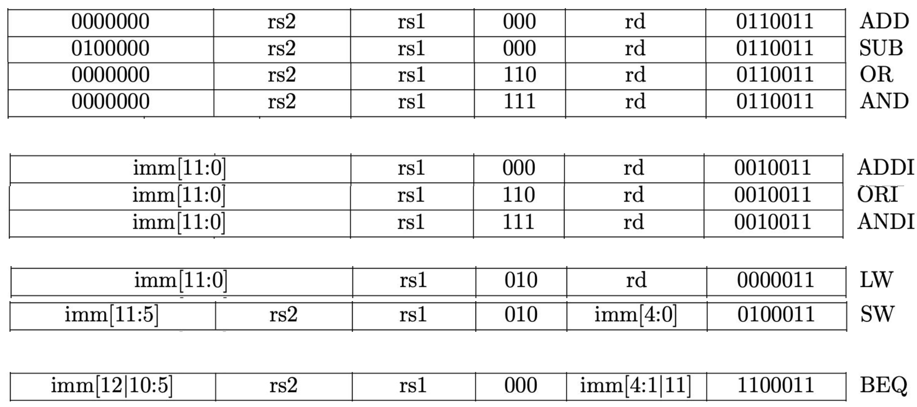
Basic RISC-V CPU Datapath
RISC-V ISA subset:
Simple hardware
ALU-R
ALU-I
LD/ST
Branch

Slide 42
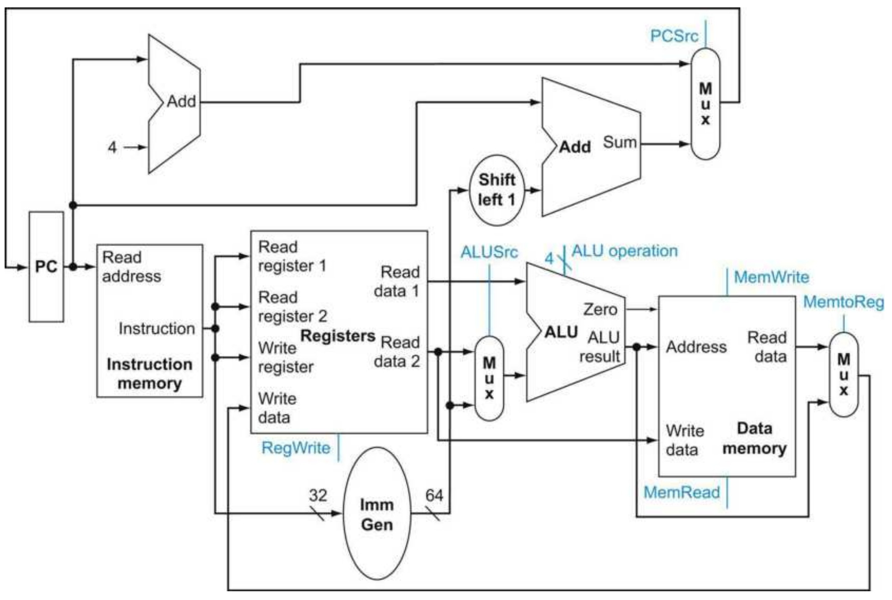
Basic RISC-V CPU Datapath
Basic Steps:
Fetch instruction from PC
Register file access
ALU execution
Memory access
Next PC update

Slide 43
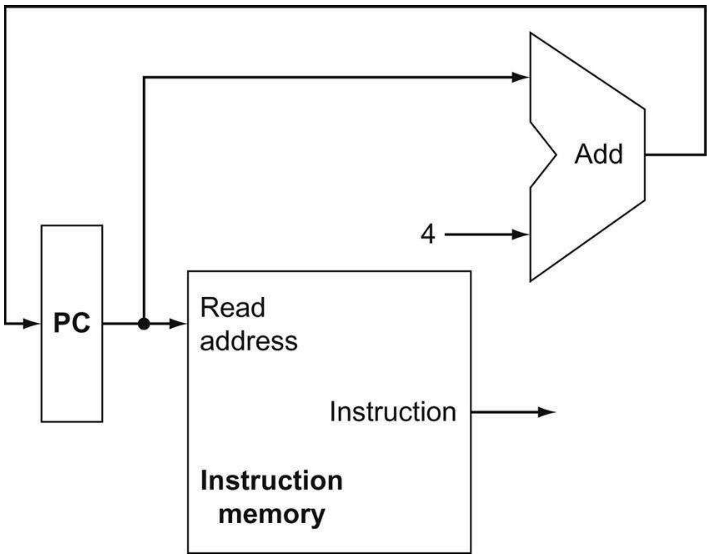
Basic RISC-V CPU Datapath
Next PC calculation:
Program counter stored in PC
Can perform the addition in parallel
While reading the next instruction

Slide 44
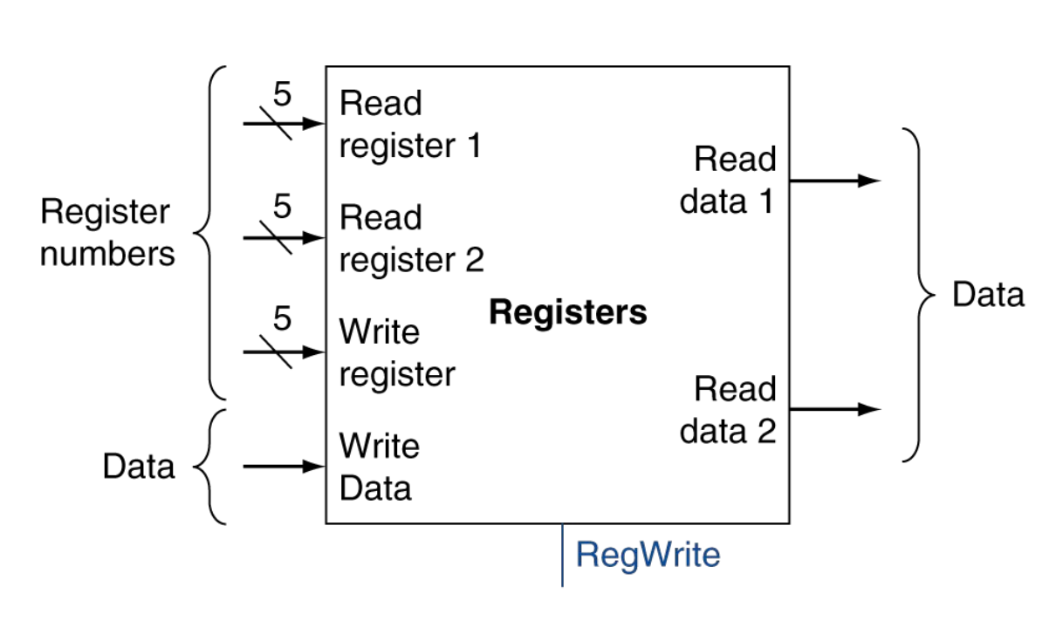
Basic RISC-V CPU Datapath
Register File:
32 total registers (5-bit addressing)
2x 5-bit source register addresses
1x 5-bit destination register address
RegWrite: write enable
How to decode register address?

Slide 45
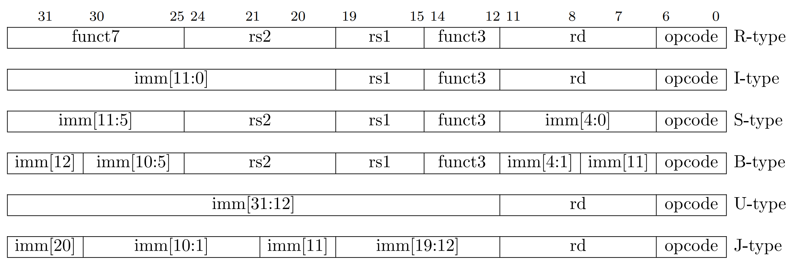
Basic RISC-V CPU Datapath
Register File:
How to decode register address?
No combinational logic needed
why?

Slide 46
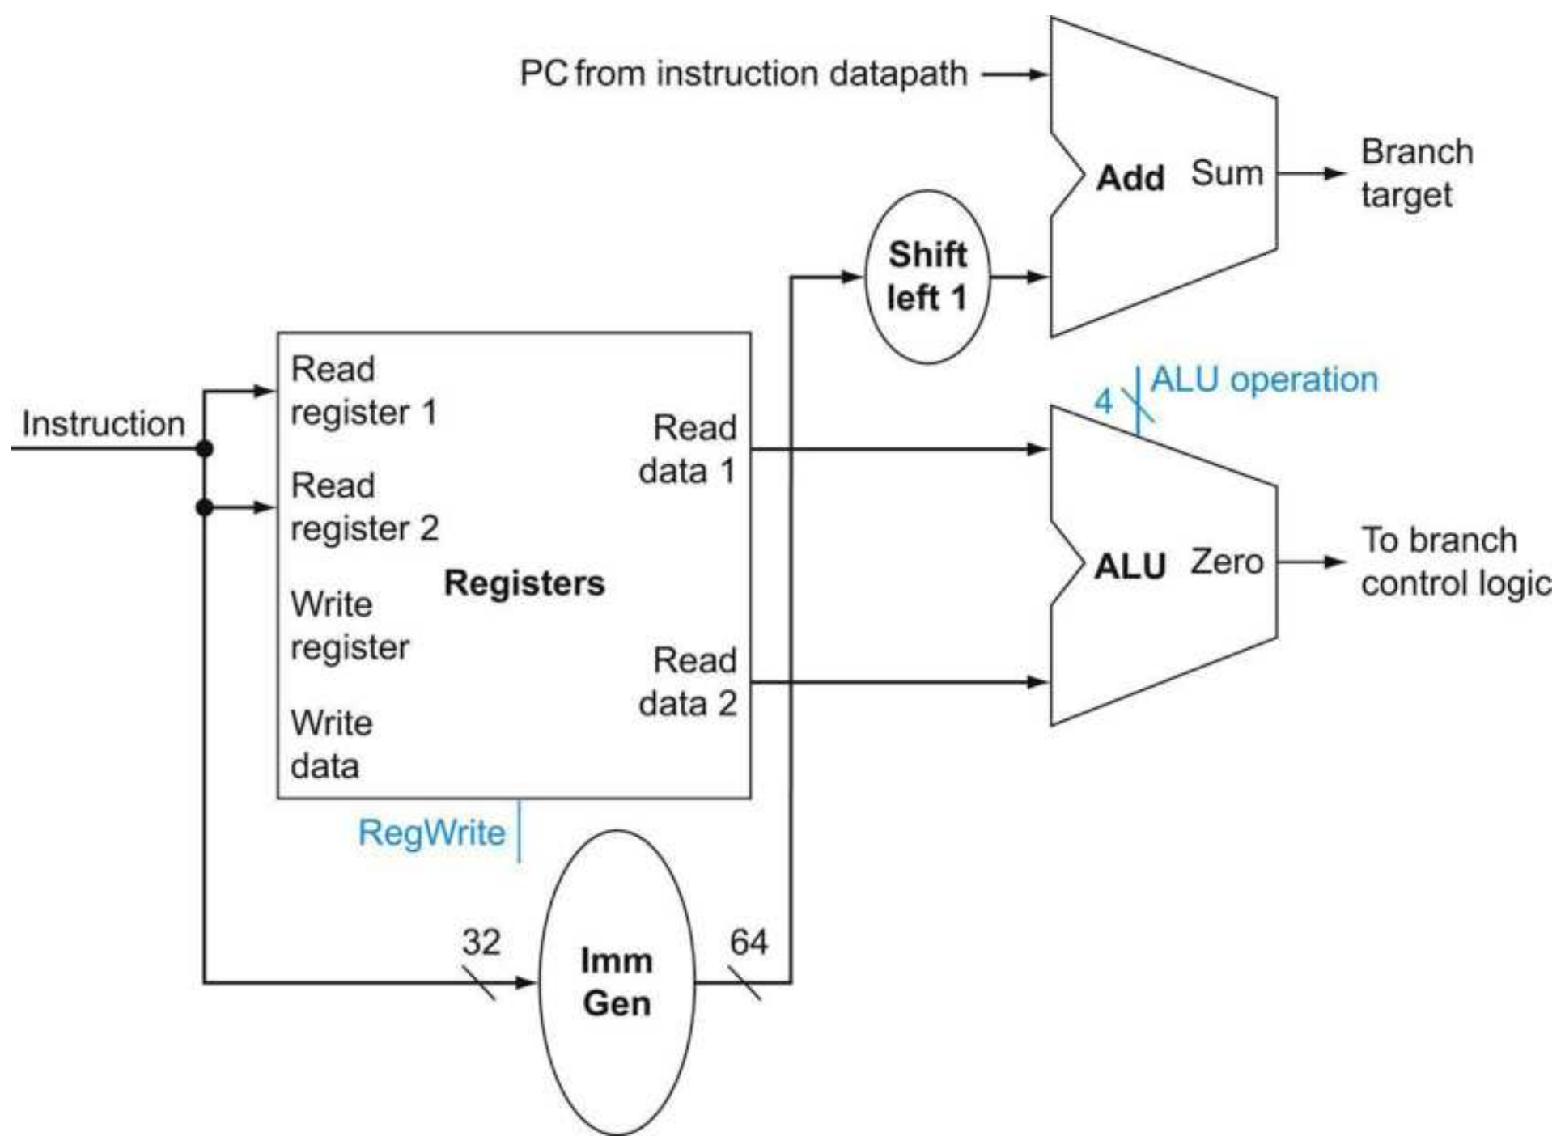
Basic RISC-V CPU Datapath
Branch operations:
Register access
Immediate generation
Branch target calculation
Branch condition evaluation
Parallelism?
2-3, 4
Critical path?
2-3

Slide 47
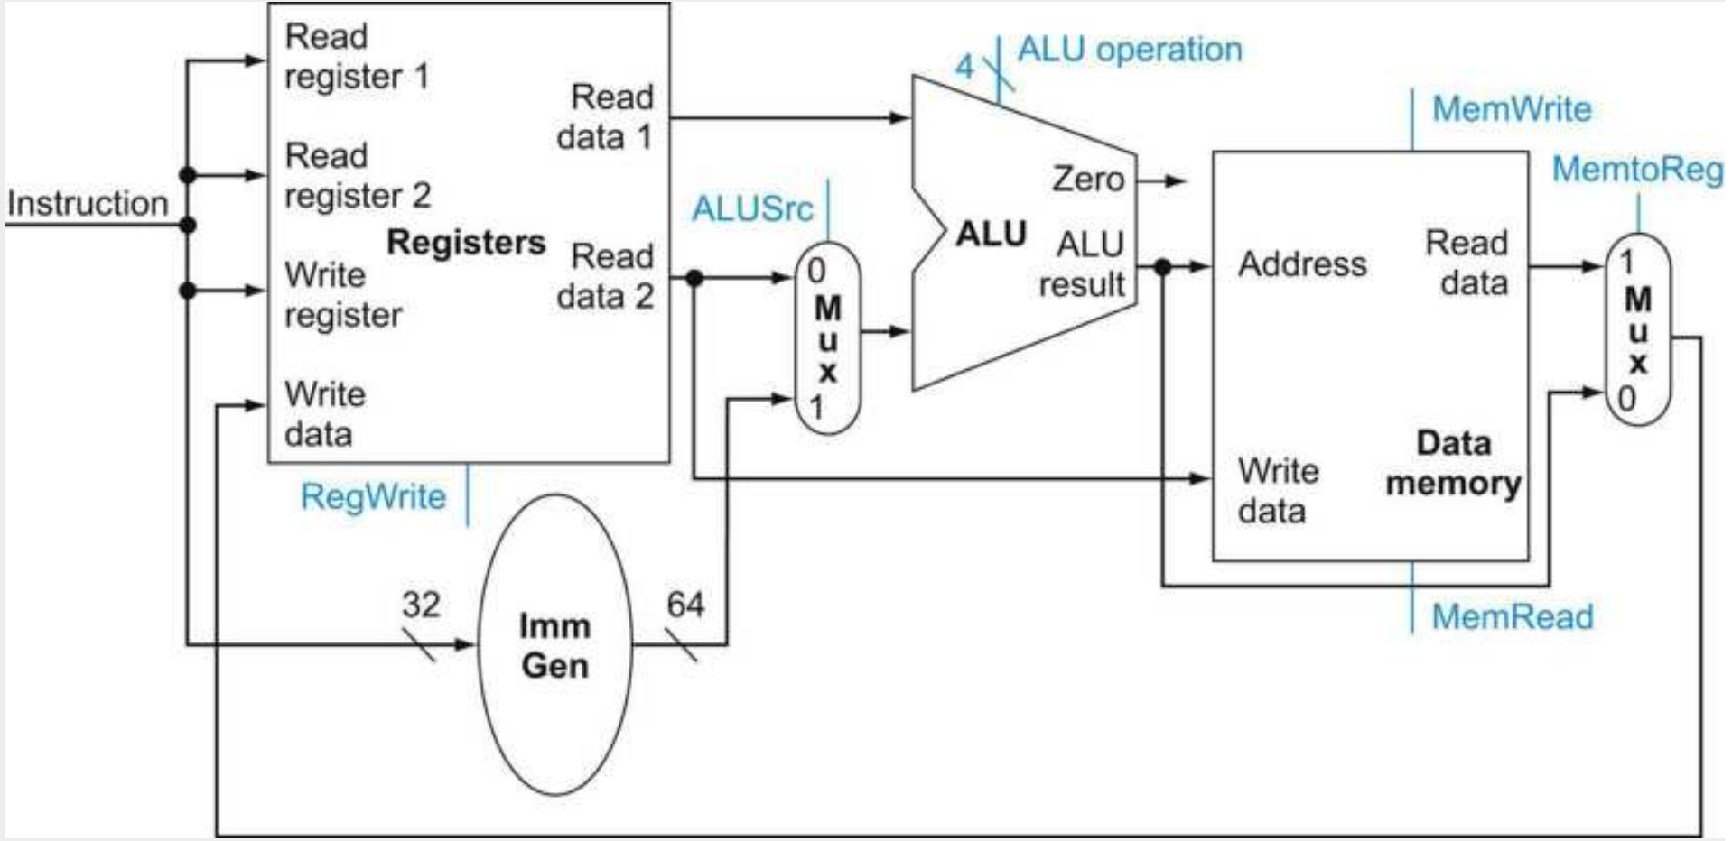
Basic RISC-V CPU Datapath
Memory Operations:
Address calculation
Memory access
ALUSrc select
0: register
1: immediate

Slide 48
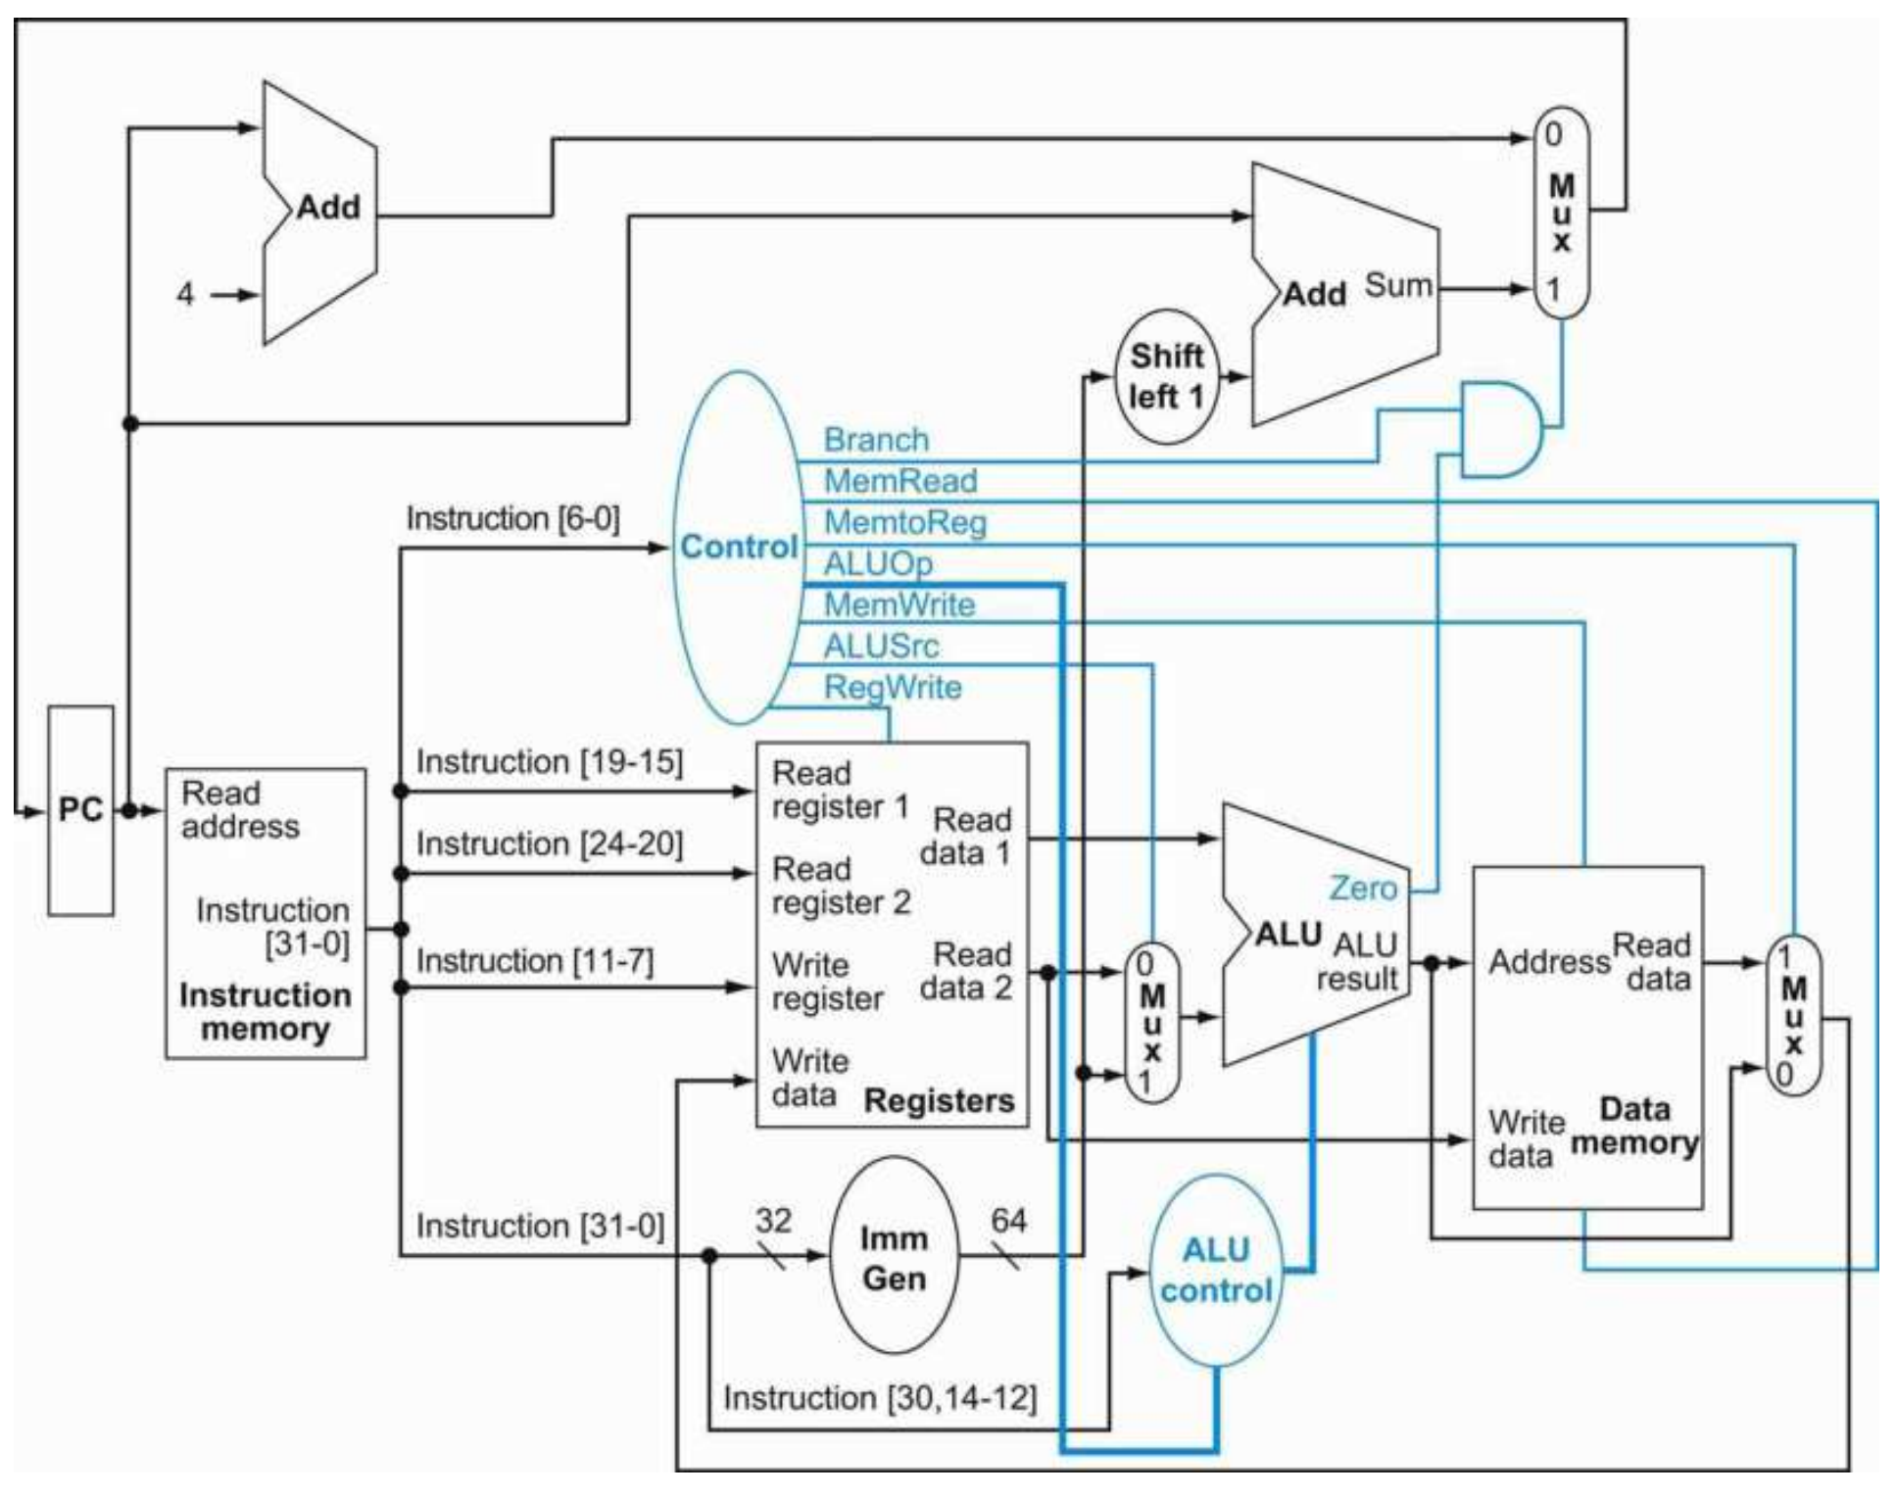
Basic RISC-V CPU Control Path
CPU control logic:
Main control
Register File
RegWrite
MemtoReg
ALU
ALUOp
ALUSrc
Data memory
MemRead
MemWrite
Branch
ALU control
ALU operation

